Slide 1
A hands-on approach on botnets for a learning purpose
Computer Systems Security

Slide 2
Agenda
What is a botnet?
Botnet anatomy

Slide 3
What is a botnet?
“A botnet is a number of Internet-connected computers communicating with other similar machines in an effort to complete repetitive tasks and objectives.”
In Wikipedia

Slide 5

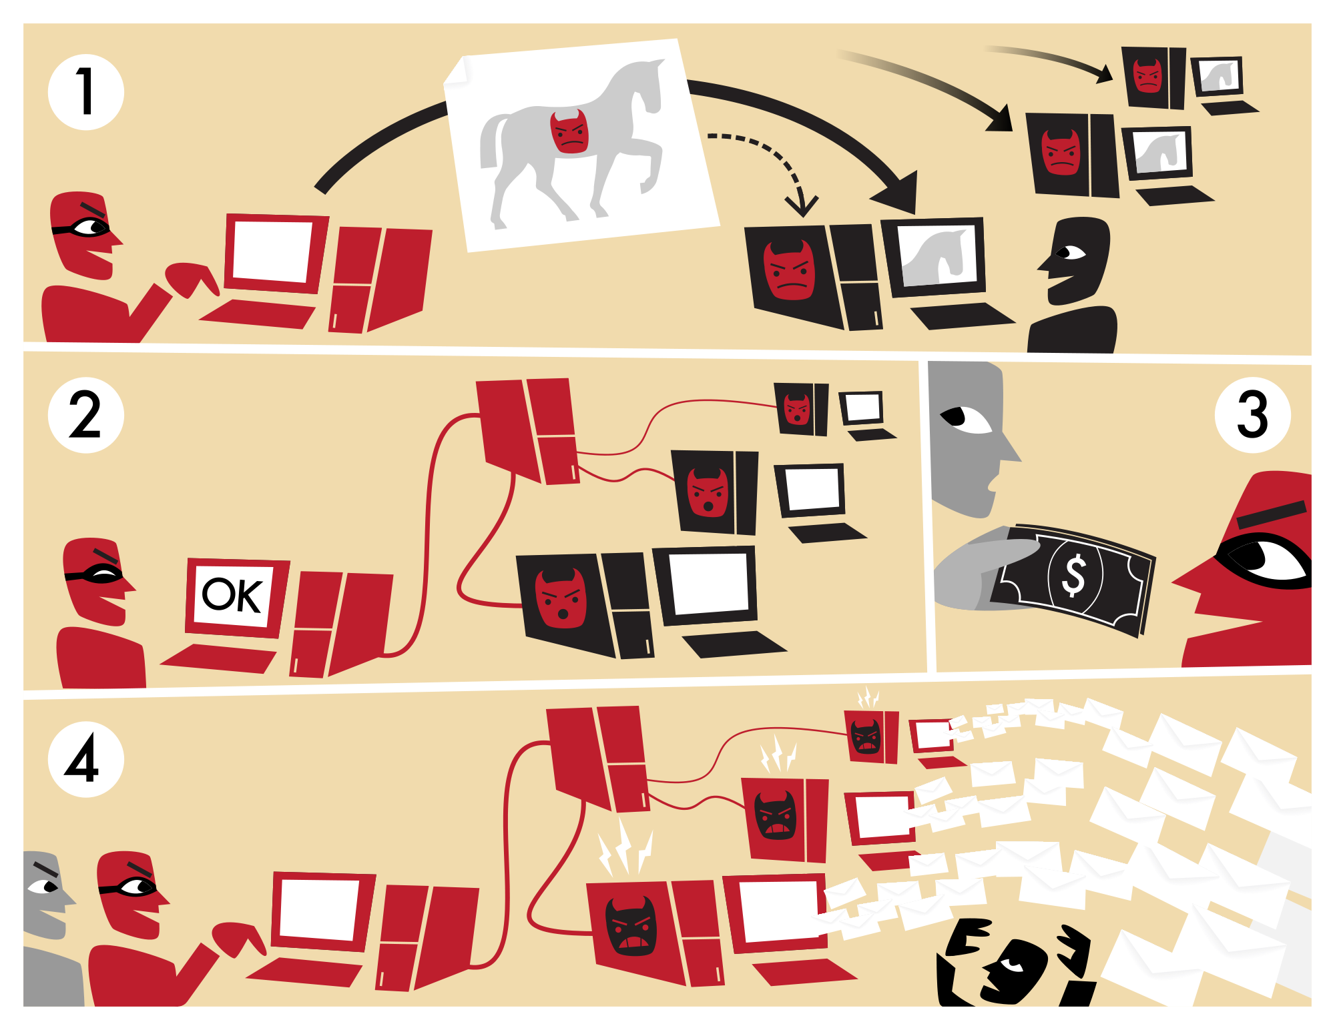


Good sides
Bad sides
Notes:
The Berkeley Open Infrastructure for Network Computing (BOINC, pronounced /bɔɪŋk/ - rhymes with "oink"[2]), an open-source middleware system, supports volunteer and grid computing. Originally developed to support the SETI@home project, it became generalized as a platform for other distributed applications
DENIS@Home is a distributed computing project hosted by San Jorge University and running on the Berkeley Open Infrastructure for Network Computing (BOINC) software platform. The primary goal of DENIS@Home is to compute large amounts of cardiac electrophysiological simulations.
SETI is an acronym for the Search for Extra-Terrestrial Intelligence. Its purpose is to analyze radio signals, searching for signs of extra terrestrial intelligence, and is one of many activities undertaken as part of SETI.

Slide 6
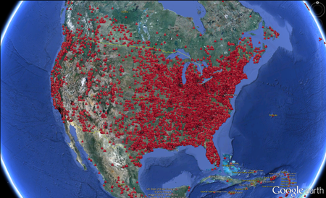
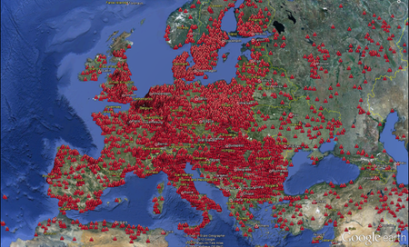
ZeroAccess botnet example
F-Secure - The ZeroAccess Botnet visualized on Google Earth

Slide 7

What will be done?

Slide 8
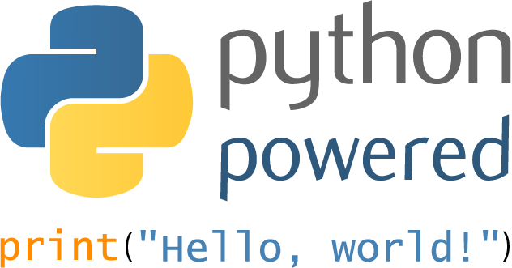
Botnet Lab Framework
IRC Bot
+
Keylogger
DDoS
Spam
Webcam Control

Slide 9

Botnet Wiki
Anatomy
History
Type of attacks
Countermeasures

Slide 10
Q & A
Thank you!
Group 6 – Theme 12
Eduardo Martins (ei11104@fe.up.pt)
João Pedro Dias (ei11137@fe.up.pt)
Jose Pedro Pinto (ei12164@fe.up.pt)
João Sá (ei11142@fe.up.pt)

